Slide 1
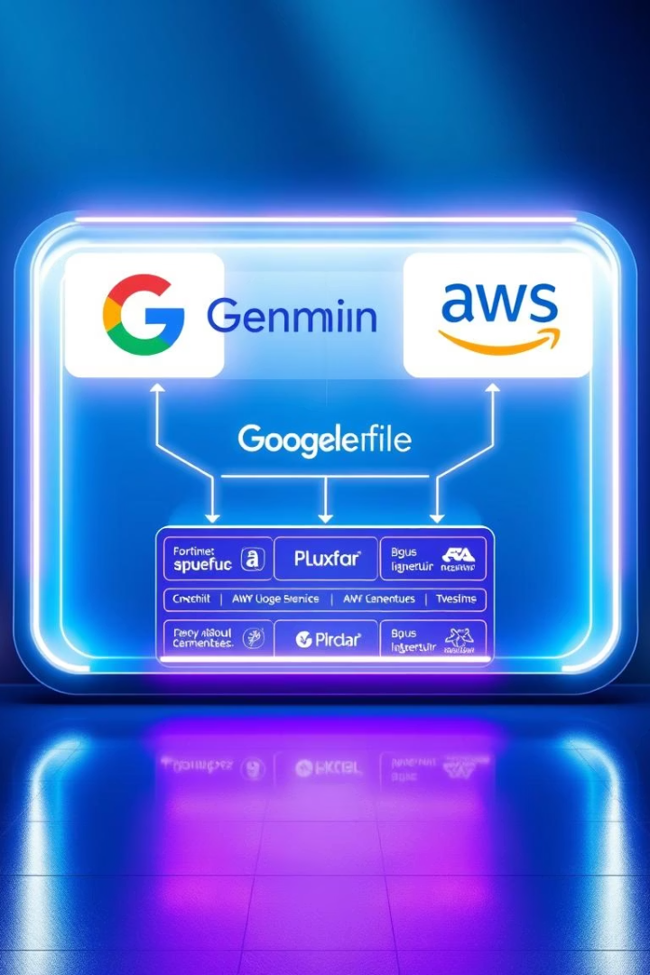

Project Walkthrough: A Serverless AI Chatbot
This presentation offers a comprehensive walkthrough of a serverless AI chatbot project, detailing its system design and implementation using Google Gemini and AWS.
by Pavan Kumar

Slide 2




Project Overview & Purpose
This project demonstrates a serverless AI chatbot designed and built from the ground up. The primary objective was to gain practical, hands-on experience with a modern, event-driven, cloud-native architecture. This presentation will cover the system design, component roles, and the end-to-end data flow, providing a clear insight into the functionality and underlying principles.
Serverless Chatbot
A demonstration of a serverless AI chatbot I designed and built.
Cloud-Native
Practical experience with modern, event-driven, cloud-native architecture.
System Insights
Covers system design, component roles, and end-to-end data flow.

Slide 3


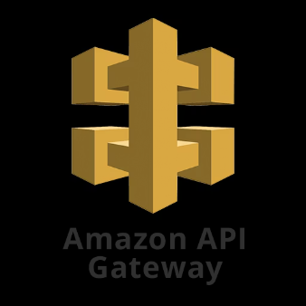
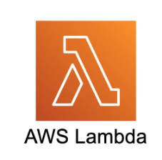

Key Components
Static Website & S3 Hosting: The frontend is a static website hosted on Amazon S3.
Client-Side Logic: JavaScript handles user input and communicates with the backend.
Amazon API Gateway: Receives requests from the frontend and securely routes them.
AWS Lambda: Executes backend logic in Python, triggered by API Gateway.
Google Gemini API: Lambda calls Gemini to generate AI responses.

Slide 4
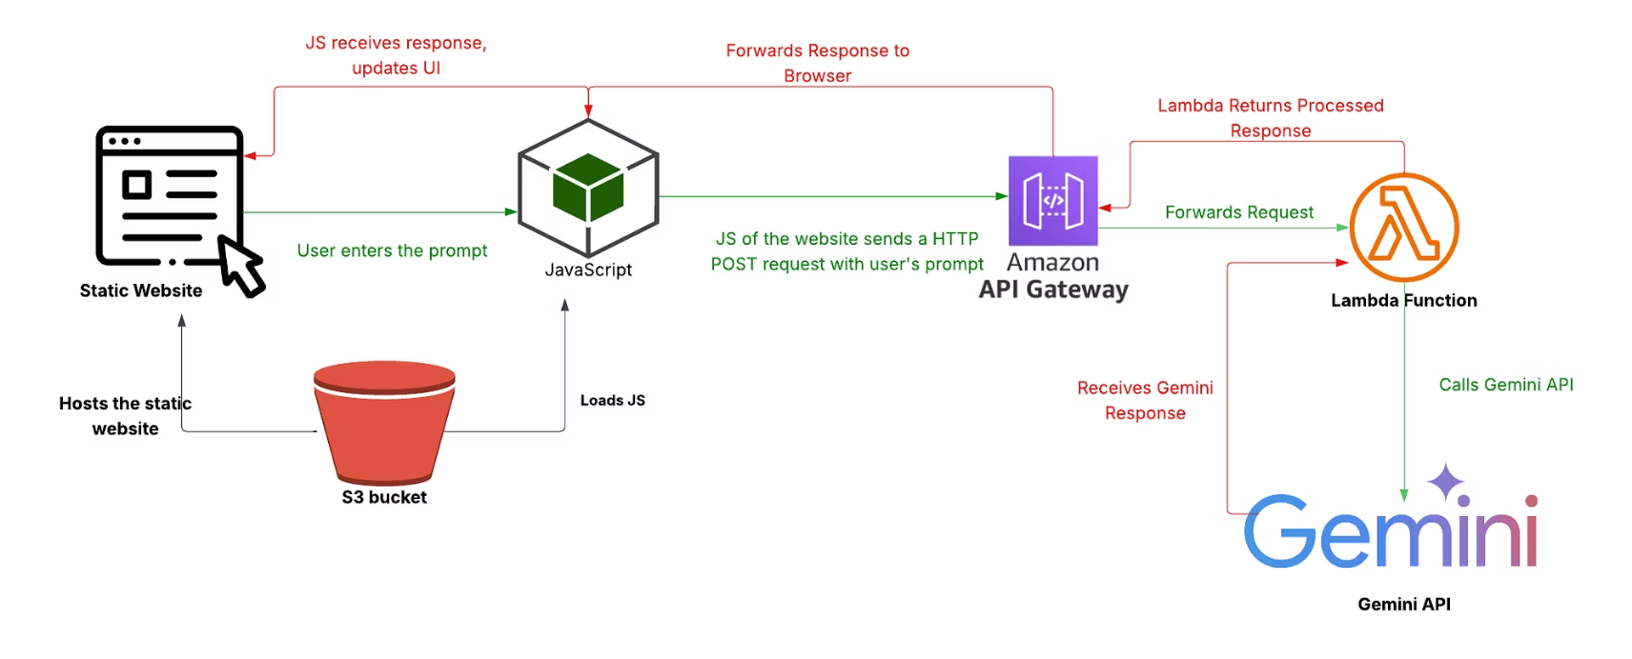
Architecture Diagram

